Slide 1

Presentation
MY

Slide 2
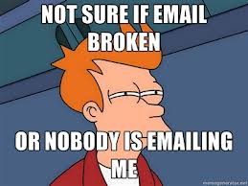


Deliverable Email

Slide 3
Optometric Extension Program Foundation (OEPF.org)
They offer training and products to those in the field of Optometry
Drupal 8 site with
Drupal Commerce
E-Store
Webform
Class Registration & Inquiries
Email Registration
User Registration
Commerce ETA
Shopping Cart reminders
Notes:
What we started with is a site, Optometric Extension Program Foundation (oepf.org)
They offer training and products to those in the field of Optometry.
We have Drupal Commerce provides an e-store and webform for inquiries and for class registrations.
We use email registration for user registration.
Commerce ETA as a cart reminder for customers

Slide 4

Email Reliability
Because we depend so much on email
Reliable delivery is important
That is why we had a lot of issues
Notes:
Because of this email provides many functions on the site.
We had issues with email being unreliable.

Slide 5
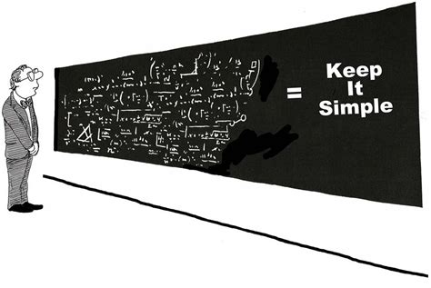
Sendgrid
Notes:
We started with using sendgrid's smtp, but had an issue with outlook 365 because our emails were coming in with a source domain of oepf.org and as far as outlook was concerned was spam (because oepf.org was an internal domain for them).

Slide 6

Outlook 365
Notes:
To get around that we started using Outlook's smtp, but we still had other issues because we were using different source email addresses depending on the destination.
Outlook would reject all but the one account that was setup for administration.

Slide 7

Outlook 365 Next Step
Notes:
Our next step was to make changes in how we interacted with Outlook 365 so it would accept the internal emails and setup all the needed mechanisms so we could send emails successfully to the other providers through Outlook 365 because we were still experiencing issues with reliable delivery and having them delivered without being marked as spam.

Slide 8

What to do now?
Notes:
At this point we are able to send internal emails to Outlook 365
But when we send emails to the other major domains like gmail, yahoo, aol, and comcast they are being marked as spam or not being delivered at all.
To make it so our email becomes trusted we had to learn how to configure our domain so it is accepted by everyone else.
Enter SPF, DKIM & DMARC.

Slide 9
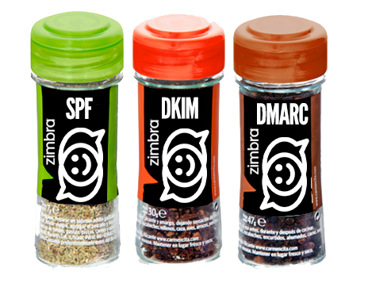
Enter SPF, DKIM & DMARC

Slide 10
For Combating Spam & Phishing
Spam & phishing mail messages have been a problem since the Internet became popular and it keeps growing.
Despite the numerous attempts at creating anti-spam tools, there’s still a high number of unwanted messages sent every day.
To combat spam email three tools were developed, SPF, DKIM and DMARC.

Slide 11
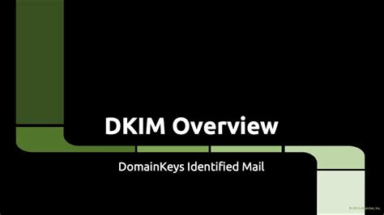

DKIM
DomainKeys Identified Mail

Slide 12

What is DKIM?
It’s an authentication technique that allows the receiver to check an email to make sure it was sent and authorized by the owner of that domain.
The receiver checks that the email is signed with a valid DKIM signature to verify that the email hasn’t been modified.

Slide 13

DKIM Header
DKIM-Signature (email header):
v=1; a=rsa-sha256; d=example.net; s=newyork;
c=relaxed/simple; q=dns/txt; t=1117574938; x=1118006938;
h=from:to:subject:date:keywords:keywords;
bh=MTIzNDU2Nzg5MDEyMzQ1Njc4OTAxMjM0NTY3ODkwMTI=;
b=dzdVyOfAKCdLXdJOc9G2q8LoXSlEniSbav+yuU4zGeeruD00lszZ
VoG4ZHRNiYzR
Notes:
v=1 Version. Always equals to ‘1’.
a=rsa-sha256 Signing algorithm (so the one used to create a DKIM record on the sender’s end). Usually, it’s either rsa-sha or rsa-sha256. There are other algorithms but they’re not always supported by receiving clients.
d=example.net The domain of a sender of a message (where DKIM is signed)
s=newyork Selector. This includes instructions on which public key to
use to resolve a given DKIM (more about it later).
c=relaxed/simple Canonicalization algorithm that’s used for both header and body.
q=dns/txt Query method that’s used to retrieve the public key. By default, it’s ‘dns/txt’
t=1117574938 A timestamp of when the message was signed
x=1118006938 Expire time of this DKIM (if an email arrives after the expiry time,
the verification will fail even if everything else matches perfectly)
h=from:to:subject: List of headers, separated by colons. date:keywords:keywords;
bh=MTIzNDU2Nzg5M The hashed message body, after being DEyMzQ1Njc4OTAxMj canonicalized with the method from ‘c’ tag and M0NTY3ODkwMTI= then run through the hash function from tag ‘a’.
b=dzdVyOfAKCdLXdJO And finally, this is the digital signature of both c9G2q8LoXSlEniSbav+ headers and body, hashed with the very same yuU4zGeeruD00lszZVo function. G4ZHRNiYzR

Slide 14
How to add a DKIM signature
Adding DKIM requires making changes to your DNS records.
How this is done is covered with larger email providers like:
MailChimp AWeber
SendGrid Gmail
Sendinblue Mailjet
Outlook & Office 365

Slide 15
Manually Creating DKIM records
Create a Txt Record on the DNS Server
Type: TXT
Name: [selector/key]._domainkey.[Domain].
value: v=DKIM1; p=[YourPublicKey]
Selector: [key]
Example
Type: TXT
Name: key001._domainkey.tel99.com.
value: v=DKIM1; p=[YourPublicKey]
Selector: key001

Slide 16
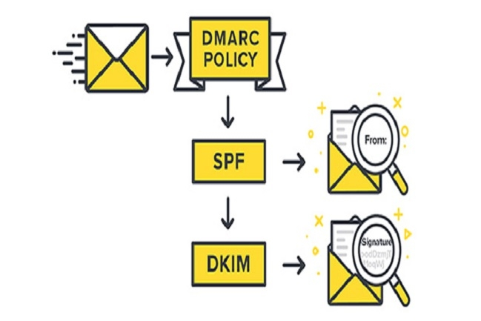
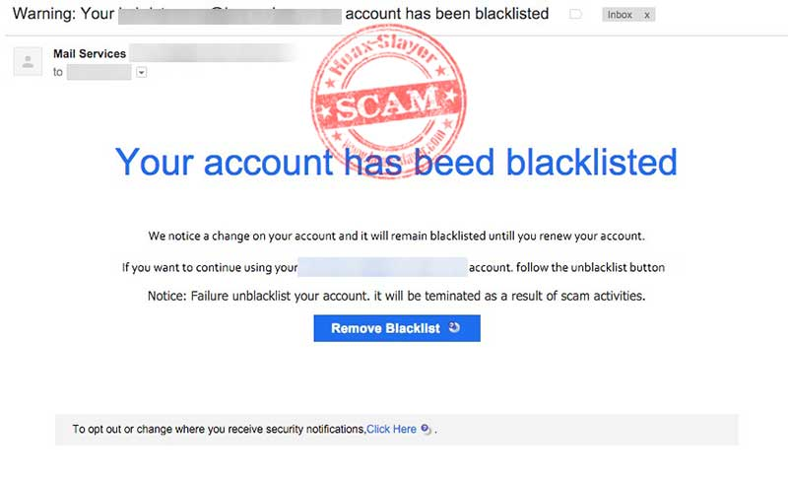
How to test DKIM
DKIM records should be validated after being created
There are many sites that do testing like MXToolbox or Mail-tester.com

Slide 17
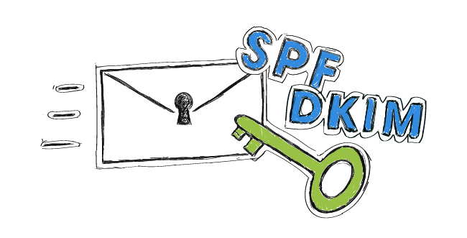

SPF
Sender Policy Framework

Slide 18
What is SPF?
It is a protocol that helps mail servers decide whether to receive or reject an incoming email based on its source address/domain.
This is done using information in TXT records that lists authorized IP addresses & domains.
If the email has been sent from one of these sources, it can be accepted as legitimate.

Slide 19
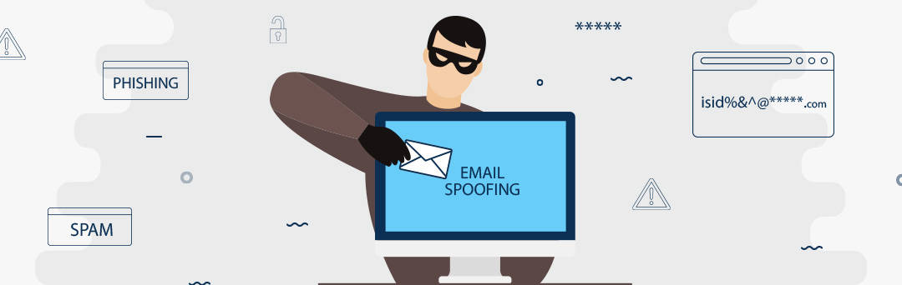
What makes up an SPF Record
Simple SPF record
v=spf1 mx a include:<domain> ip4:x.x.x.x -all
Example:
v=spf1 mx a include:smtp.emailacct.com include:smtp.sendgrid.net ip4:24.34.6.87/32 ~all
Notes:
v=spf1 States the spf version (does not change)
mx Defines the DNS MX record of the domain as authorized
a Defines the DNS A record of the domain as authorized.
If unspecified, the current domain is used
include Includes the specified domain as authorized
all Defines policy for all other sources
+ Accept. The host is allowed to send a message
- Reject. The host is not allowed to send a message
~ Accept but mark. The host is not allowed to send a message but is
in transition (the mechanism is for testing purposes)
? Accept. The host validity is unstated (unknown)
Other tags:
Ip4 Defines the IPv6 network range. Can be used with prefix,
which denotes the range length. If no prefix is specified,
/32 is be default
Ip6 Defines the IPv6 network range. Can be used with prefix,
which denotes the range length. If no prefix is specified,
/128 is be default
exp Specifies the explanation that a sender will see if the
message has been rejected
redirect Replaces domain with the current record

Slide 20

Create SPF Record
Create a TXT record in DNS
Example SPF Record:
Type: TXT
Name: @
Value: v=spf1 mx a include:mail.example.com -all

Slide 21

DMARC
Domain-based Message Authentication Reporting and Conformance

Slide 22
What is DMARC?
DMARC was the result of collaboration between engineers from Microsoft, PayPal, Yahoo! and Google.
It uses DKIM and SPF to perform more advanced checks on emails that are received.
SPF validates that the source of the email is authorized.

Slide 23
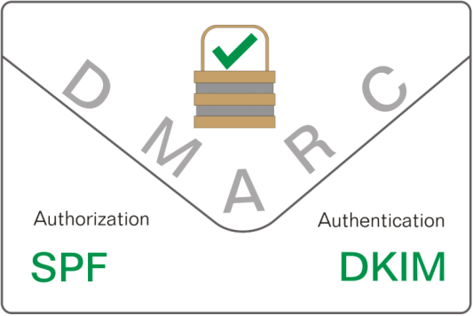
What is DMARC? (cont.)
DKIM uses a digital signature to authenticate the email.
The receiving server is able to recreate the values with a public key and compare it against the signature received.
If the values don’t match, the DKIM check fails.
The DMARC record instructs the incoming server as to what action to take with an email that has failed.

Slide 24
DMARC and Failed Emails
DMARC has 3 choices for when a failed email is received:
‘None’ – directs that the email should be treated as if no DMARC was set up (a message can still be delivered, put in spam or discarded based on the other factors).
‘Quarantine’ – allow the email but it’s not to be delivered to an inbox (usually, such messages go into the spam folder).
‘Reject’ – discard the message that fails the check.

Slide 25
DMARC and Failed Emails (cont.)
The receiving server will send reports for failed DMARC verification with data about the failures to the location specified.
This is for analyzing the performance of your messages and to keep you aware of any phishing and spam attempts.
This enables you to be proactive when issues occur.

Slide 26

DMARC Record
A sample DMARC record:
v=DMARC1;
p=reject;
rua=mailto:dmarc-rua@square.com,mailto:dmarc_agg@vali.email,mailto:postmasters@squareup.com; ruf=mailto:dmarc-ruf@squareup.com
Notes:
v=DMARC1 This is the DMARC version.
p=reject The policy to be followed when an email fails;
none, quarantine, reject.
rua=mailto:dmarc-rua@ This is where you specify the addresses that will be receiving daily,
square.com,mailto: aggregate reports about the emails that failed the verification.
dmarc_agg@vali.email,
mailto:postmasters Each address added needs to be proceeded with “mailto:”
@squareup.com
ruf=mailto:dmarc-ruf@ This is an email address where individual forensics reports
squareup.com will be sent in real-time, including the details of each failure.

Slide 27

Recap
SPF checks that the IP address the email comes from is authorized
DKIM checks the message using keys for signature-verification
DMARC provides
instructions on what to do when an email fails
Provides reporting back to the source about issues

Slide 28

Links
What is SPF
https://www.sparkpost.com/resources/email-explained/spf-sender-policy-framework/
What is DKIM
https://www.sparkpost.com/resources/email-explained/dkim-domainkeys-identified-mail/
What is DMARC
https://www.sparkpost.com/resources/email-explained/dmarc-explained/
Tools
MX ToolBox
https://mxtoolbox.com/NetworkTools.aspx?tab=
Mail-Tester
https://www.mail-tester.com/

